Slide 1


Slide 2


Slide 3
上课内容：自然拼读
上课时间：每周六晚19：00 - 20：30
上课老师：尹岩老师

Slide 4
A is for apple [æ] [æ] [æ]
B is for bat [b] [b] [b]
C is for cat [k] [k] [k]
D is for dog [d] [d] [d]
E is for elephant [e] [e] [e]
F is for frog [f] [f] [f]
G is for girl [g] [g] [g]

Slide 5
H is for head [h] [h] [h]
I is for it [i] [i] [i]
J is for jug [dʒ] [dʒ] [dʒ]
K is for kite [k] [k] [k]
L is for lion [l] [l] [l]
M is for monkey [m] [m] [m]
N is for nose [n] [n] [n]

Slide 6
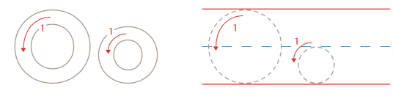
Oo
字母读音： [əu]
字母发音： [ɔ]

Slide 7
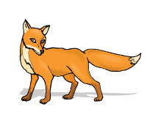

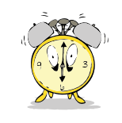
O is for orange [ɔ][ɔ][ɔ]
fox
dog
clock

Slide 8
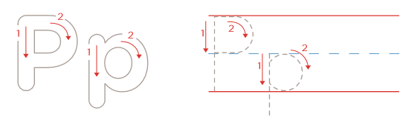
Pp
字母读音： [pi:]
字母发音： [p]

Slide 9
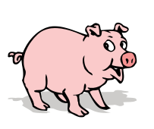
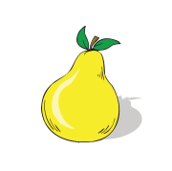

P is for pear [p] [p] [p]
pig
pear
piano

Slide 10
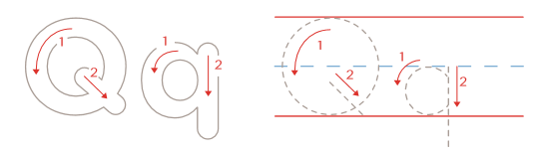
Qq
字母读音： [kju:]
字母发音： [kw]

Slide 11
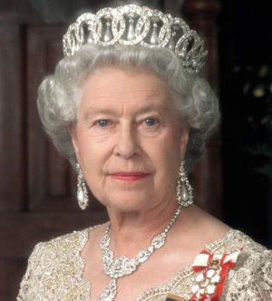
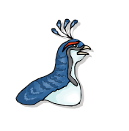

Q is for queen [kw] [kw] [kw]
queen
quail
question

Slide 12


Slide 13
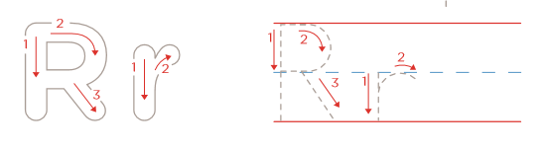
Rr
字母读音： [a: r]
字母发音： [r]

Slide 14
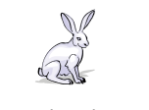


R is for rain [r] [r] [r]
rabbit
run
ring

Slide 15
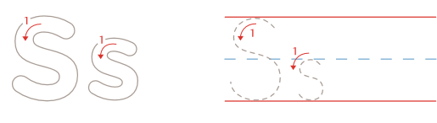
S s
字母读音： [es]
字母发音： [s]

Slide 16



S is for sweet [s] [s] [s]
sun
seal
bus

Slide 17
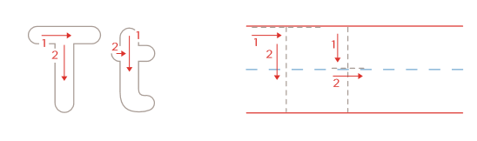
T t
字母读音： [ti:]
字母发音： [t]

Slide 18


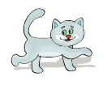
T is for tiger [t] [t] [t]
tie
turtle
cat

Slide 19
O is for orange [ɔ][ɔ][ɔ]
P is for pear [p] [p] [p]
Q is for queen [kw] [kw] [kw]
R is for rain [r] [r] [r]
S is for sweet [s] [s] [s]
T is for tiger [t] [t] [t]

Slide 20


